Slide 1
Front End Engineering-I Project
Team Details:
ADARSH KUMAR GUPTA-2210991177
ADARSH KUMAR PATHAK-2210991178
ADARSH RANJAN-2210991179
ADITI-2210991180
Faculty Coordinator:
LEEMA NELSON
:
Chitkara University Institute of Engineering and Technology,
Chitkara University, Punjab

Slide 2
Table of Contents
Introduction
Problem Statement
Technical Details
Key Features
Project Highlights
Bonus Feature(optional)
Conclusion
References/Links used

Slide 3
Introduction
Tribute Page:
Robert Downey jr.
Purpose: A tribute page on Robert Downey Jr. would serve to honor and celebrate the life, career, and achievements of this talented actor and filmmaker. Downey Jr. has had a long and varied career in Hollywood, and has overcome personal struggles and setbacks to become one of the most beloved and respected actors of his generation.
Celebrate His Career
Recoginze his talent
Commomorate his personal struggles
Goal: The goal of a tribute page on Robert Downey Jr. would be to create a fitting tribute to this accomplished actor and filmmaker. The page would aim to inform and inspire visitors, while celebrating Downey Jr.'s life, career, and achievements. Here are some specific goals that a tribute page on Robert Downey Jr. could aim to achieve:
Provide biographical information
Celebrate his contributions
Inspire visitors
Encourage engagement

Slide 4
Problem Statement
Aim: Robert Downey jr. aims to celebrate the life and achievements of the popular American actor and producer. It aims to showcase his early beginings as a child actor , his struggles with addiction , and his triumphant return to the limelight. The tribute page also aims to highlight his iconic roles in various movies and TV shows, his contributions to the Marvel Cinematic Universe, and his philanthropic work.
Baground Information: The section aims to give readers a basic understanding of Robert Downey Jr's background, including his early life, family, and education. It aims to provide an overview of his acting career, from his early days as a child actor to his breakout roles in the 1980s and 1990s. The section may also touch on his personal struggles with addiction and legal troubles, which impacted his career.The problem statement of this section is to give readers a clear and concise introduction to Robert Downey Jr's life and career, laying the groundwork for the more detailed information to come in the rest of the tribute page. By providing this background information, readers will have a better understanding of who Robert Downey Jr is, what he has accomplished, and why he is being honored with a tribute page.
Research: The research section may also delve into his personal life, including his marriage and children, as well as his philanthropic work.this section is to present the information in an organized and easy-to-read manner, using credible sources such as interviews, articles, and biographies. By conducting thorough research, the tribute page can provide readers with an in-depth understanding of Robert Downey Jr's life and career, showcasing his achievements and impact on the entertainment industry.

Slide 5
Technical Details
Html And CSS:
We use html and css only to design our website

Slide 6
Key Features
Introduction:
An introductory section that provides a brief overview of Robert Downey Jr's life, career, and why he is being honored with a tribute page.
Background Information: A section that provides a more in-depth look at Robert Downey Jr's background, including his early life, family, education, and early career.
Career Highlights: A section that highlights some of Robert Downey Jr's most notable roles in movies and TV shows, including his work in the Marvel Cinematic Universe.
Personal Life: A section that delves into Robert Downey Jr's personal life, including his relationships, family, and philanthropic work.
Legacy and Impact: A section that discusses Robert Downey Jr's impact on popular culture and his legacy as an actor and producer.
Multimedia Content: The tribute page may include photos, videos, and other multimedia content that showcases Robert Downey Jr's talent and achievements.
Quotes: The tribute page may include quotes from Robert Downey Jr himself or from others in the entertainment industry about his impact and influence.
Call-to-Action: The tribute page may include a call-to-action encouraging readers to learn more about Robert Downey Jr's work or to donate to a charity he supports.

Slide 7
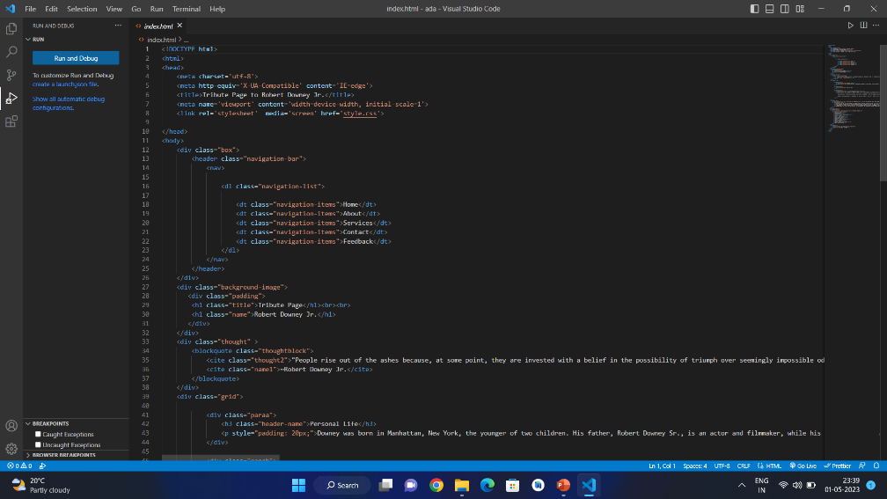
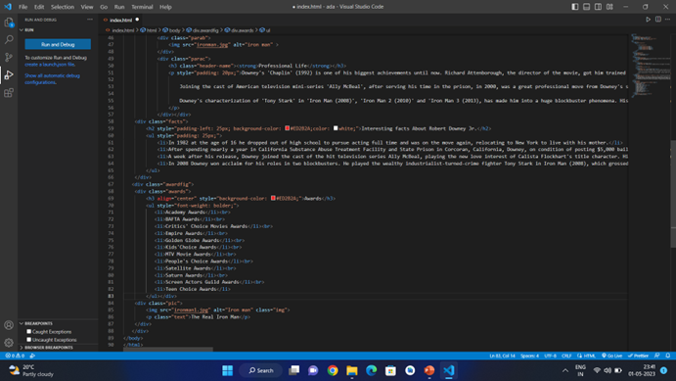
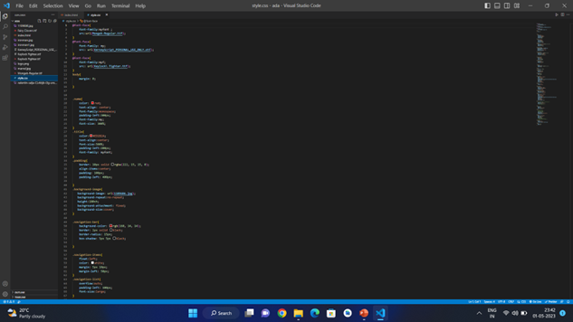
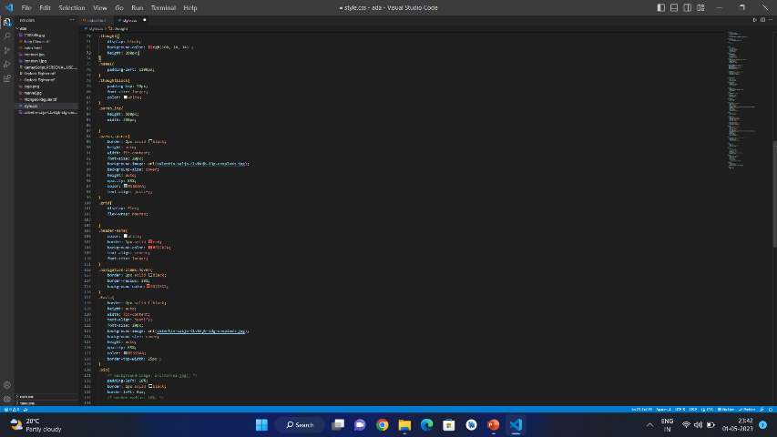
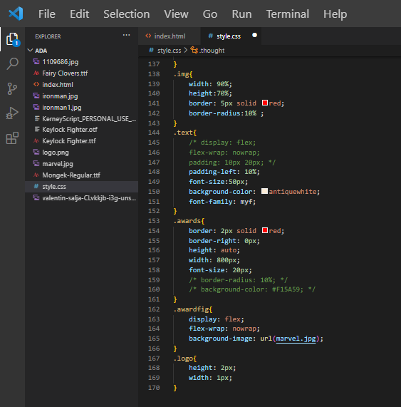
Project Highlights
Html Cde
CSS Code

Slide 8
Bonus Feature(optional)

Slide 9
Conclusion
Provide a comprehensive and respectful tribute to Robert Downey Jr's life and career.
Celebrate his talent, resilience, and dedication to his craft.
Highlight his notable roles in movies and TV shows, including his work in the Marvel Cinematic Universe.
Showcase his personal life, including his relationships, family, and philanthropic work.
Discuss his impact on popular culture and his legacy as an actor and producer.
Present information in an organized and easy-to-read manner, using credible sources of information.
Include multimedia content such as photos and videos to showcase Robert Downey Jr's talent and achievements.
Encourage readers to learn more about Robert Downey Jr's work or to donate to a charity he supports.
In conclusion, a tribute page on Robert Downey Jr provides a platform to honor and celebrate his life and career, showcasing his impact on the entertainment industry and his lasting legacy as a beloved and iconic figure.

Slide 10
References/Links used
CSS Url Link: style.css
Image Url Link: ironman.jpg
Image Url Link: ironman1.jpg
Src Url Link: Mongek-regular.ttf
Src Url Link: KerneyScript_PERSONAL_USE_ONLY.otf
SrcUrl Link: Keylock\ Fighter.ttf
Baground Image Url Link: 1109686.jpg
Baground Image Url Link: valentin-salja-CLvkkjb-i3g-unsplash.jpg
Baground Image Url Link: marvel.jpg

